Slide 1
Let’s Play!
HIV Risk Assessment and Conducting a Sexual History
Jeannette Southerly, BSN, RN, ACRN

Slide 2
Why Ask about Sex?
The U.S. has the highest rate of STDs in the industrialized world (8/2018)
CDC estimates nearly 2.3 million new STIs occur every year in the US, half of those young people aged 15–24
Rates:
  gonorrhea rose by 67%
  syphilis by 76%
  chlamydia by 21%
According to the CDC, 2017 surpassed 2016 as the year with the most reported STD cases on record—and marked the fourth year in a row that STDs increased steeply in the U.S.
Because Sex is a Health Matter!!!

Slide 3
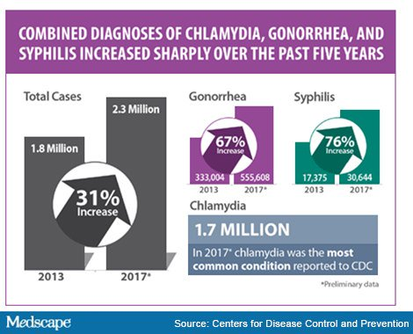

Slide 4
Percentage of High School Students Who Were Ever Tested for HIV,* by Sex, Grade,† and Race/Ethnicity, 2015
*Not including tests done when donating blood
†12th > 10th (Based on t-test analysis, p < 0.05.)
All Hispanic students are included in the Hispanic category. All other races are non-Hispanic.
Missing bar indicates fewer than 100 students in this subgroup.
Note: This graph contains weighted results.
West Virginia - YRBS, 2015 - QN85
Notes:
Data for this slide are from the 2015 West Virginia Youth Risk Behavior Survey. This slide shows the percentage of high school students who were ever tested for HIV (not including tests done when donating blood).
The percentage for all students is 13.1. The percentage for Male students is 12.9. The percentage for Female students is 13.4. The percentage for 9th grade students is 11.9. The percentage for 10th grade students is 10.8. The percentage for 11th grade students is 11.8. The percentage for 12th grade students is 17.9. The percentage for White students is 12.5. All Hispanic students are included in the Hispanic category. All other races are non-Hispanic. Note: This graph contains weighted results. Missing bar indicates fewer than 100 students in this subgroup.
For this behavior, the prevalence for 12th grade students is higher than for 10th grade students. (Based on t-test analysis, p < 0.05.)

Slide 5
Don’t Ask, Don’t Know, Don’t Tell
64% women 18-44 said it’s up to health professional to initiate conversations about STDs
YET
Only 10% said health professional raised subject of STDs other than HIV/AIDS
Only 3% brought up STDs themselves

Slide 6
We Don’t Ask
Less than 40% of primary care clinicians obtain a sexual history routinely in new adult patients
We ask even less often during successive visits
Diamant et al. 2000
Notes:
Studies show that a minority of primary care clinicians obtain a sexual history routinely when seeing adult patients for an initial office visit– a visit that should be comprehensive enough to include this part of the history.
Clinicians ask even less often during successive visits– a fact that is most unfortunate when you consider that sexual behavior changes over time, and there may be new, clinically-relevant information to be obtained.

Slide 7


Slide 8
Sex Education Not Adequate in Most US Schools
In most U.S. states, fewer than 1/2 of high schools and just 1 in 5 middle schools teach essential sex education topics recommended by the CDC, according to a CDC report.
The report shows the percent of schools providing sexual health education that meets CDC's criteria is generally low and varies widely by state. Among the key findings for schools that teach all essential topics were:
    high schools (grade 9, 10, 11, or 12) ranges from 21% to 90%
    middle schools (grade 6, 7, or 8) ranges from 4% to 46%
With nearly ¼ of HIV diagnoses and ½ of all STI in the U.S. occurring among those under 25, sex education in schools represents a missed opportunity for delivering critical HIV & STD prevention knowledge & skills
U.S. Centers for Disease Control and Prevention - December 9, 2015

Slide 9
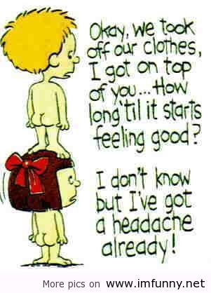

Slide 10
Taking a Comprehensive History
Discuss sexual identity/orientation:
  Assess level of self-acceptance
Identify risk behaviors for:
  Unintended pregnancy
  Sexually transmitted diseases
Ask about sexual abuse
Ask about sexual satisfaction
Notes:
By taking a comprehensive sexual history that includes discussing sexual identity and orientation, identifying risk behaviors and a history of sexual abuse, and asking about sexual satisfaction…

Slide 11
Sexual History
Prepare the patient:
“Now I am going to take a few minutes to ask you some direct questions about your sexual health. These questions are very personal, but it is important for me to know so I can help you be healthy. I ask these questions to all of my patients regardless of age or marital status and they are just as important as other questions about your physical and mental health. Like the rest of this visit, this information is strictly confidential.”

Slide 12
Things to Remember
Remember the patient may need to express fears or concerns, and to relieve the stress associated with this type of interview. It is important providers display a non-judgmental attitude so patients are comfortable revealing sexual behaviors.
Throughout the interview remember to reinforce behaviors that reduce risk, (eg condom use) and reiterate and tailor prevention messages as you get to know your patient’s sexual history.
Identify and reduce barriers to obtain sexual history. Address issues of confidentiality. Patients may reveal situations that are outside the norm or illegal.
Have a plan to deal with a third party. Sexual histories should be between the patient and provider

Slide 13
The CORES Model
Clarify what the patient is saying, especially if they use jargon and generalizations
Be objective in how you ask questions and respond to answers
Reassure the patient about confidentiality
Show empathy for the patient’s condition, lifestyle or situation
Summarize what the patient says so you can check for understanding
Remember to look for both verbal and non-verbal cues

Slide 14
Partners
Partners in lifetime, 12 months, 2 months
Who, what, when, where and how
Inquire about the gender of sex partners (ask everyone about gender of sex partners – don’t single out)
Ask about partner’s risk factors including current or past sex partners and drug use
If more than one partner is noted in last 12 months explore more specific risk factors such as condom use (or non-use) and partner risk-factors
Inquire if patient has ever exchanged sex for drugs, gifts or money

Slide 15
Teens
Care needs to be taken when introducing sensitive topics such as sexuality with teenagers.
It is important to interview the teen alone and reinforce confidentiality.
Start with asking about neutral topics like school, sports, or other activities.
Discussions should be appropriate for the teen’s developmental level and you should be explicit.

Slide 16
Practices
Prepare patient for explicit dialogue about sexual practices
“What kind of sexual contact do you have or have you had?”
Genital - penis in the vagina
Anal - penis in the anus
Oral - mouth on penis, vagina, or anus
Use of sex toys
Use of drugs/alcohol, esp. IDU

Slide 17
Risk of HIV Infection by Sexual act or Activity
Exposure Type
(sexual act or activity)
Blood Transfusion
Needle Sharing (for IDU)
Receptive (bottom) unprotected anal sex
Needle Stick
Receptive unprotected vaginal sex
Insertive (top) unprotected anal sex
A man getting a blow job
A man giving a blow job to another man
Average chance of becoming HIV+ per exposure
9 in 10
13.4 per 2000 exposures
10 per 2000 exposures
6 per 2000 exposures
2 per 2000 exposures
1.3 per 2000 exposures
0.2 per 2000 exposures
0.1 per 2000 exposures
based on: MMWR (January 21, 2005 / 54(RR02);1-20)

Slide 18
STIs
“Have you, your current or past partners ever been diagnosed with an STI? When, where, what, how”
Ask patient if they would like to be tested
  HIV, chlamydia, gonorrhea, syphilis, trichomoniasis
Explain procedures for specific testing (i.e. blood-work, genital exam, oral swab)
History of HPV or abnormal PAP
History of Herpes

Slide 19
Pregnancy
You may determine a patient is at risk for becoming pregnant or fathering a child. Determine if pregnancy is desired. Make questions gender specific.
“Are you trying to conceive or father a child?”
“Are you using contraception or any form of birth control?”
“Do you need information or a referral for birth control?”

Slide 20
Concluding the Sexual History
Thank the patient for being open and honest and praise protective practices
Inquire about patient’s concerns regarding the interview
Ask if patient has other questions about their sexual health or practices
Address high-risk practices (talk about prevention)
Make referrals or develop plan for testing

Slide 21
Summary:
When Should We Ask?
As often as possible:
  At every routine visit
  Whenever clinically pertinent:
    Ask patients with pharyngitis about oral sex
    Ask patients with suspicious injuries (bruises on breasts, genitals) about a history of abuse
Notes:
The bottom line is that sexual behavior is fluid– it changes over time. Therefore it isn’t sufficient to ask only during an initial visit and nevermore. We must ask again and again over time.
It is also to continually keep in mind that sexual exposures are no infrequently part of the clinical picture. For example, undiagnosed pregnancy must be considered in young women with abdominal pain; sexually-acquired pathogens in the setting of infection; and sexual abuse in patients who present with suspicious injuries or chronic pain syndromes.

